Slide 1


Restaurant Menu Application

Slide 2
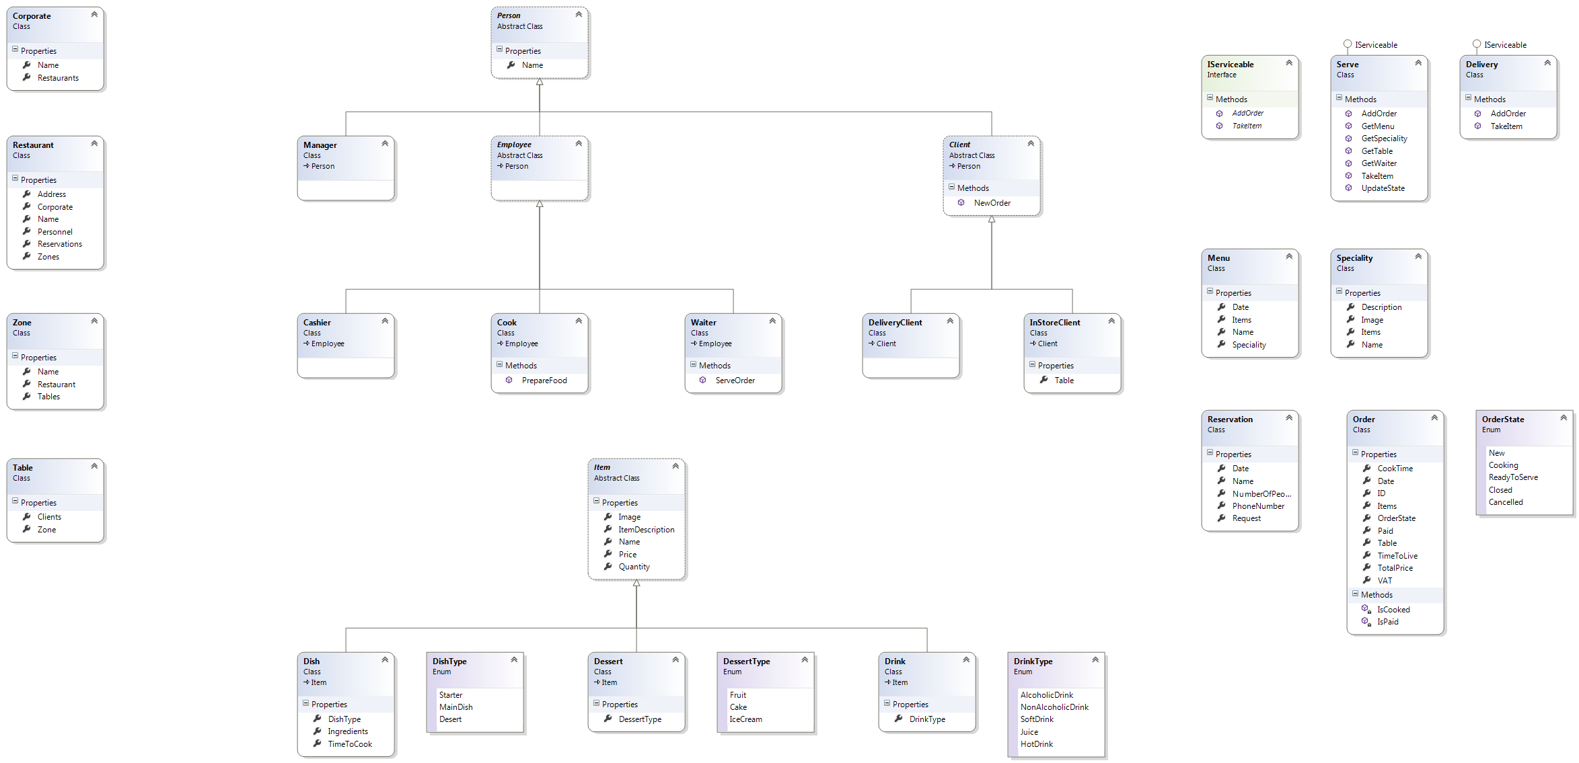
Class Diagram

Slide 3
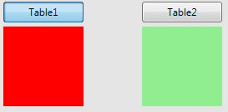
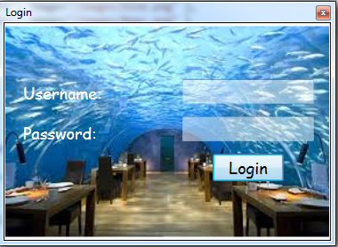
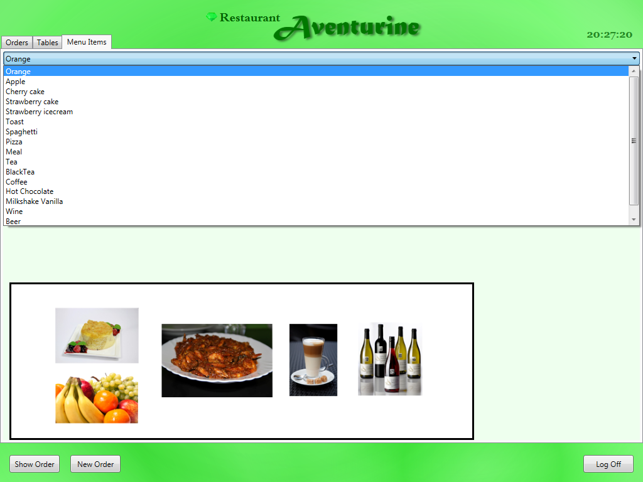
Menu and buttons
At project start a Login windows requires user name and password
For accessing the main menu
Togglebuton provides double function for Free (green color) and Reserved table (red color)
ComboBox provides slide function with selection of data options from a created class from menu items

Slide 4
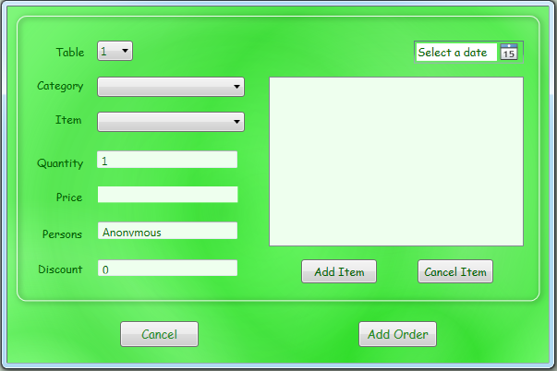
Menu and buttons
when button is pressed
the NewOrder window is called for adding orders
when button LogOff is pressed from the Main Window the whole application is closed, for usage user has to Login again.

Slide 5
THANK YOU FOR USING OUR APPLICATION!

